Slide 1
Advanced Data Analysis
Cox proportional hazards model
Shenyang Guo, PhD
Overview
The Partial likelihood estimator
Model fitting and significance test
Handling tied survival times
Interpreting the estimated model using hazard ratios
Interpreting the estimated model using model-based survival curves

Slide 2
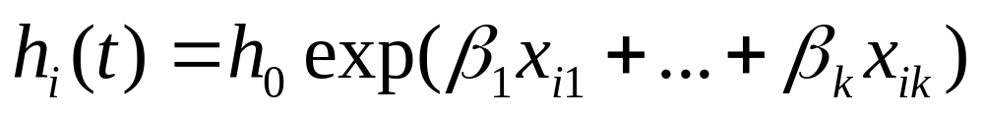
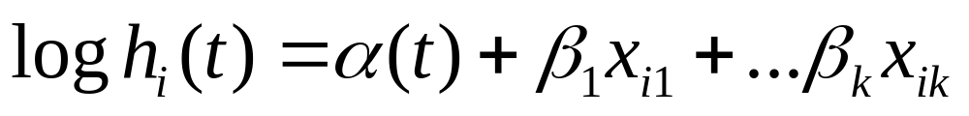
Overview (1)
Basic model
Key features: (1) no requirement for the assumption about the underlying distribution of survival times; (2) it assumes a constant ratio of the hazards for any two individuals – this is why the model is called “proportional hazard model”.

Slide 3
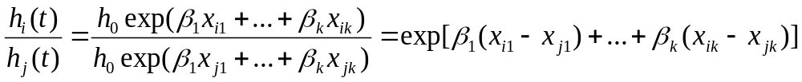
Overview (2)
Proportionality
The model assumes that the hazard for any individual is a fixed proportion of the hazard for any other individual.
Graphically, the hazard functions for any two individuals should be strictly parallel.
What’s important is that h₀(t), the baseline hazard rate, cancels out of the numerator and denominator. This means that you can estimate β coefficients of the model without having to specify the baseline hazard rate h₀(t).
Violation of assumption about proportionality is not a serious problem.

Slide 4
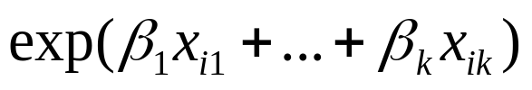
Partial likelihood estimation of the proportional hazard model (1)
Because h₀(t) cancels out, Cox developed a method called partial likelihood estimation, which discards the baseline hazard, and only treats the second part of the equation, (i.e., ) as though it were an ordinary likelihood function. He called this “partial likelihood”. The method aims to maximize the partial likelihood function.

Slide 5
Partial likelihood estimation of the proportional hazard model (2)
I now will show you how PL works. Two purposes: (1) understand Cox regression and PL; and (2) have a taste about the general procedure of maximum likelihood estimation (the fundamental estimator for almost all models covered by this course!)
Recall, 3 steps for MLE:
  Develop a likelihood function (maximize likelihood that reproduce your sample);
  Plug in starting values for Bs;
  Using a numeric approach to test different sets of Bs (iteration, convergence, and convergence criterion).

Slide 6
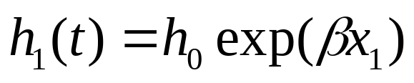
Partial likelihood estimation of the proportional hazard model (3)
The following demonstration is only for single-parameter-no-ties data (Allison 122-126).
Step 1: Develop PL function
Sort data in an ascending order of T (survival times);
The hazard for individual 1 is:

Slide 7
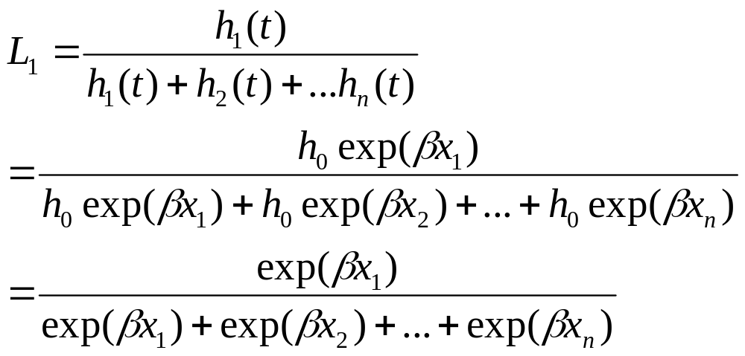
Partial likelihood estimation of the proportional hazard model (3)
The likelihood for individual 1 to have the event at time t is: “hazard / (risk set)” or
The likelihood is equal to the hazard for case 1 at time t divided by the sum of the hazards for all cases who were at risk of having the event at time t.

Slide 8
Partial likelihood estimation of the proportional hazard model (4)
Comments on three important features of the likelihood:
Baseline hazard is cancelled out;
As a result, the likelihood function is totally expressed by βx – the coefficient to be determined and the predictor;
The model carefully takes the information of censoring cases into consideration when building the likelihood function – censoring cases were not excluded, but whose information was built into the construction of risk set!!
Notes:
3. Recall life table: hazard = number failed / (next interval + half (censored + failed).

Slide 9
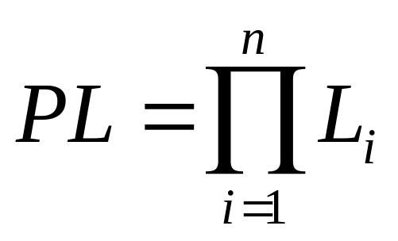
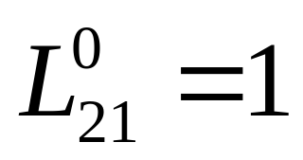
Partial likelihood estimation of the proportional hazard model (5)
The total likelihood function for the sample is then written as a product of the likelihoods for all cases in the sample:
and define the likelihood for a censoring case (e.g., case 21, Dead=0) as .
Reason: No event, censored!

Slide 10
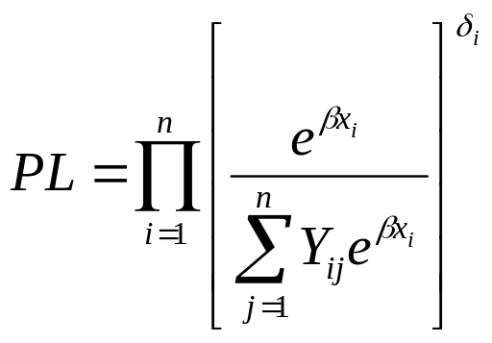
Partial likelihood estimation of the proportional hazard model (6)
Putting together or more formally,
Where Y_{ij}=1 if t_{j}>t_{i}; and Y_{ij} = 0 if t_{j}<t_{i}. Here δ_{i} is the censoring indicator and serves like a switcher (on/off). Again, the likelihood function for censoring cases is “no event” or “excluded” (multiply by 1), but the information is taken into consideration in the denominator or risk set.

Slide 11
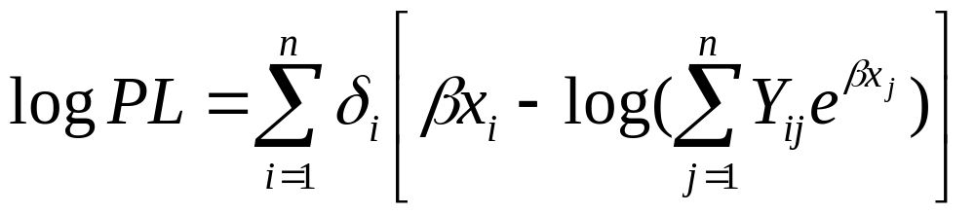
Partial likelihood estimation of the proportional hazard model (7)
It’s convenient to take a logarithm of the PL, and maximize log PL:
Step 2: Plug in starting value of β;
Step 3: Search the best β until you maximize log PL.
See how this works from the Excel program.

Slide 12
Partial likelihood estimation of the proportional hazard model (8)
The excel program was designed to maximize the following function:
An important note: Only works for one-predictor-no-ties data. Copyright: Guo.

Slide 13
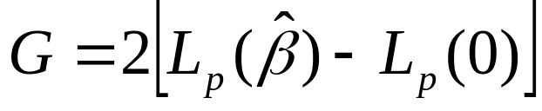
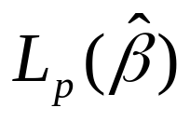
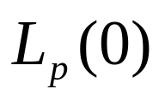
Model fitting and significance test (1)
To determine whether an estimated Cox model fits the data to an acceptable degree, we perform a likelihood ratio test:
where denotes the log likelihood of the model containing all covariates, and the log likelihood evaluated at all βs equal to 0.
The test statistic G is subject to a chi-square distribution with a given degree of freedom (i.e., the number of independent variables included).

Slide 14
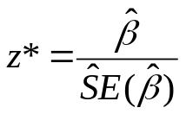



Model fitting and significance test (2)
There are three methods to assess the significance of the estimated coefficient:
The Wald test (recommended):
The Wald statistic z* is:
Using z* we perform a two-tailed or one-tailed z test.
2. The partial likelihood ratio test using
where is the log likelihood of the model containing the covariates being tested, and is the log likelihood of the reduced model without the test covariates. Using G to perform a chi-square test with df=p where p is the number of test covariates.

Slide 15
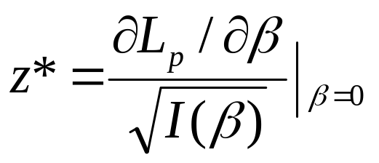
Model fitting and significance test (3)
The score test:
The test statistic is the ratio of the derivative of the log partial likelihood to the square root of the observed information all evaluated at β=0:
Using z* we perform a two-tailed or one-tailed z test.
Note: Stata does not provide the score test. SAS and SPSS report square of the z* that follows a chi-square distribution. In practice, results from the Wald and score tests are very close.

Slide 16
Handling tied survival times (1)
When some cases are tied on event times (i.e., two or more cases whose events occur at the same time), you need choose appropriate method to handle ties.
General ideas: consider true time ordering for the tied cases. Four methods:
  Breslow (default in Stata & SAS): assumes that the observed ties occurred sequentially.
  Efron: consider all possible underlying orderings that might exist, but use a numeric approximation to simplify the computations.
  Exact: consider all possible orderings (time-consuming: 5!=120 possible ordering).
  Discrete: assumes time is really discrete.

Slide 17
Handling tied survival times (2)
How to choose a method to handle ties? Efron is highly recommended.
Computing time today is not a concern, therefore, the exact methods (both Exact and Discrete) can always produce good results.
My own experiences: no big differences. I always choose Efron.

Slide 18

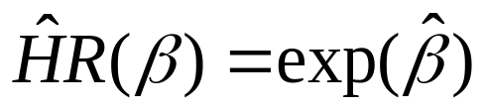
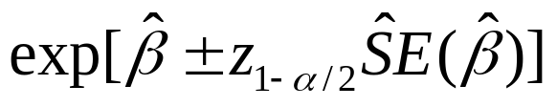
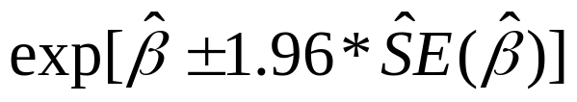
Interpretation based on hazard ratio (1)
As a convention, we interpret the finding of a Cox regression by using hazard ratio (HR). Instead of , we use exp( ).
100(1-α)% confidence interval:
95% confidence interval:
A 95% CI dose not include value 1 is an indication that the HR is significant at the .05 level.

Slide 19
Interpretation based on hazard ratio (2)
  Examples of interpretation based on hazard ratio (Allison, 1995, p.117)
  Continuous variable: B(age) = -.057246, exp(B)=.944, 1-.944=.056 “for each one-year increase in the age at release, the hazard of arrest goes down by an estimated 5.6%”;
  Dummy variable: B(financial aid) = -.379022, exp(B)=.685, “the hazard of arrest for those who received financial aid is only about 69% of the hazard for those who did not received aid, controlling for all other variables”. Alternatively you can compare exp(B) with value 1 to do a 1-exp(B) or exp(B)-1 to talk about the hazard rate for the group that is X% lower (or X% higher) than that of the reference group. That is, do 1-.685=.315, and say “the hazard of arrest for those who received aid is 31.5% lower than those who did not.” This is similar to the interpretation of using odds ratio for a logistic regression.

Slide 20


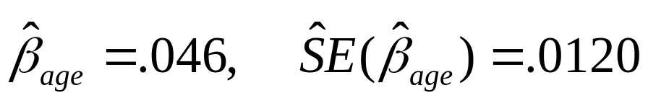
Interpretation based on hazard ratio (3)
  For continuous IV, sometime you may want to interpret the change on hazard rate by using c-units rather than one-unit on the covariate. That is, you want to use clinically interesting unit of change. For example, you may talk about hazard rate difference for every 5-years increase in age rather than an one-year increase. See Hosmer et al, pp.106-108.
  , 95%CI:
  Example:
  Every 5-year increase in age increases the hazard rate by 26%. We are 95% confident that the population true increase in the hazard rate for every 5-year increase in age is between 12% and 42%.

Slide 21
Model-predicted survivor curves (1)
Communicating complicated statistical results in a non-technical fashion: it’s a challenge.
Most important results of survival models: survivor curves.
Why survivor curves from life table or KM do not work? -- They are bivariate.
Model-predicted survivor curves: if the pattern holds, what is going to happen in the population?

Slide 22
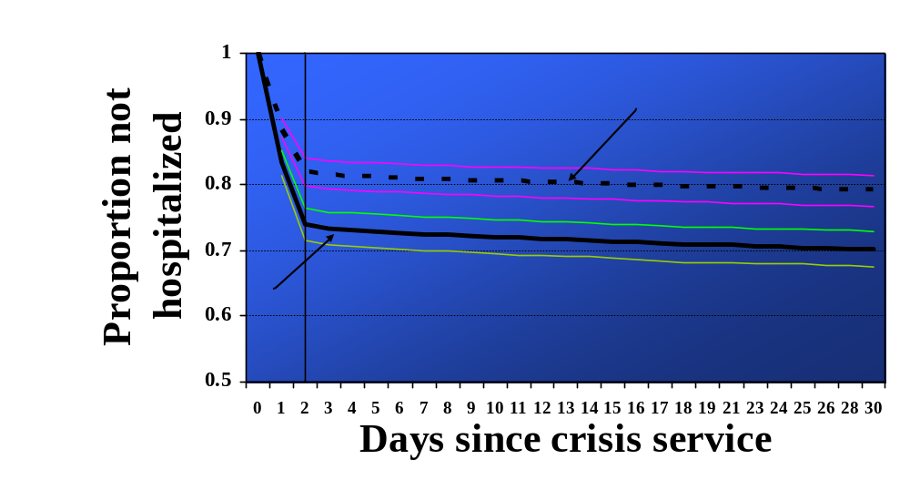
Example 1. Predicted Proportions of Consumers Not Being Hospitalized within 30 Days (Guo, et al 2001)

Slide 23
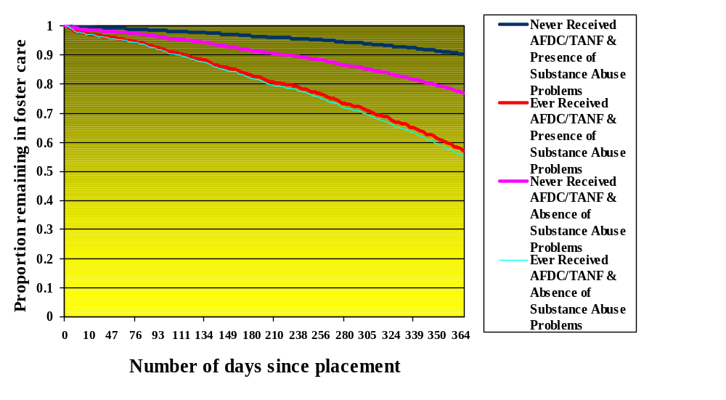
Example 2. Interactive Effects of “Never Received AFDC/TANF Post-Placement” and “Mother Substance Abuse Problems” on Speed of Reunification

Slide 24
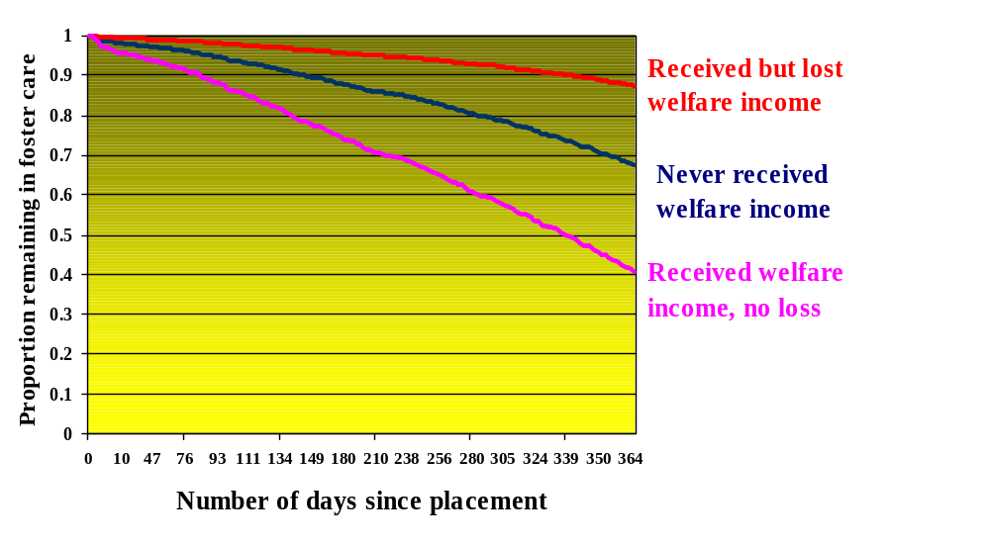
Example 3. The impact of mother’s welfare use & loss on proportion of children remaining in foster care

Slide 25
Model-predicted survivor curves (2)
The key idea of model-predicted survivor curves: “Other things being equal (or controlling for all other covariates), what is going to happen?”
How to control for all other covariates? Three methods: (1) control them at the sample mean values (Guo, pp. 88-91); (2) using the quantiles (percentiles) of the risk scores (Hosmer et al, pp.126-128) to show the selected survival curves; and (3) using the median of the modified risk scores (Hosmer et al, pp. 128-130).

Slide 26
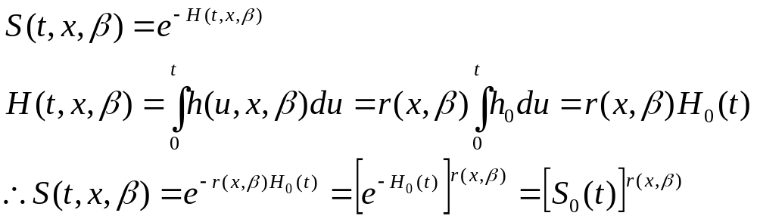
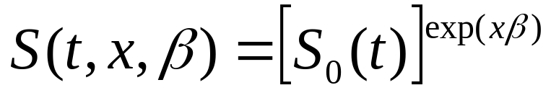
Model-predicted survivor curves (3)
The model-predicted survivor function is based on the following derivation:
Specifically, for the Cox regression:

Slide 27
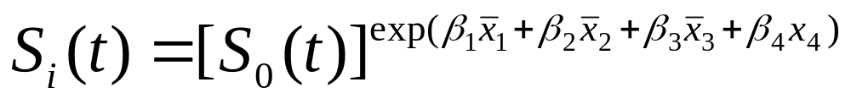
Model-predicted survivor curves (4)
Method 1: Controlling other covariates at the sample means, we have
where S₀(t) is the baseline survivor function, and i=1,2,..n, or n survivor curves of interest. You allow x₄ to change values n times. See Guo (2010, pp.88-91).
You could use any combination of covariate values of your interest.
After estimating β by partial likelihood, you can get an estimate of S₀(t) by a nonparametric maximum likelihood method. With that estimate in hand (SAS does this internally when you specify BASELINE), you can generate the model-predicted survivor function for any set of covariate values by substitution in the equation above.

Slide 28
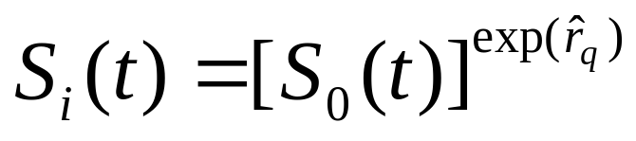

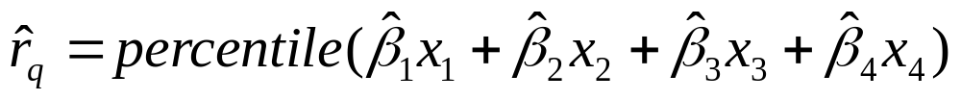
Model-predicted survivor curves (5)
Method 2: Use the percentiles of the risk scores to show selected survival curves:
where is the percentile value of the risk scores of the sample:
You choose 10th, 25th, 50th, 75th, and 90th percentile of the risk scores from the sample, and follow the same procedure to generate the model-predicted survivor curves.

Slide 29
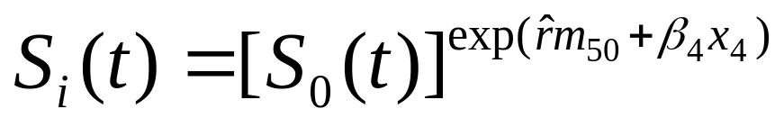
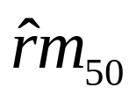
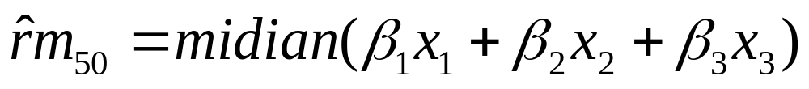
Model-predicted survivor curves (6)
Method 3: use the median of the modified risk scores, we have
where is the median value of the modified risk scores of the sample:
You use different values of x₄ to get different predicted survivor functions. You follow the same procedure to generate the model-predicted survivor curves.

